Slide 1
Year 11 pal exam revision
Unit 1 + 2

Slide 2
UNIT 1: Democracy and the rule of law
This unit examines the principles of a liberal democracy; the legislative, executive and judicial structures and processes of Australia’s political and legal system; the functioning of a non-democratic system; and the processes of a non-common law system.
Political and legal developments and contemporary issues (the last three years) are used to provide a framework for the unit

Slide 3
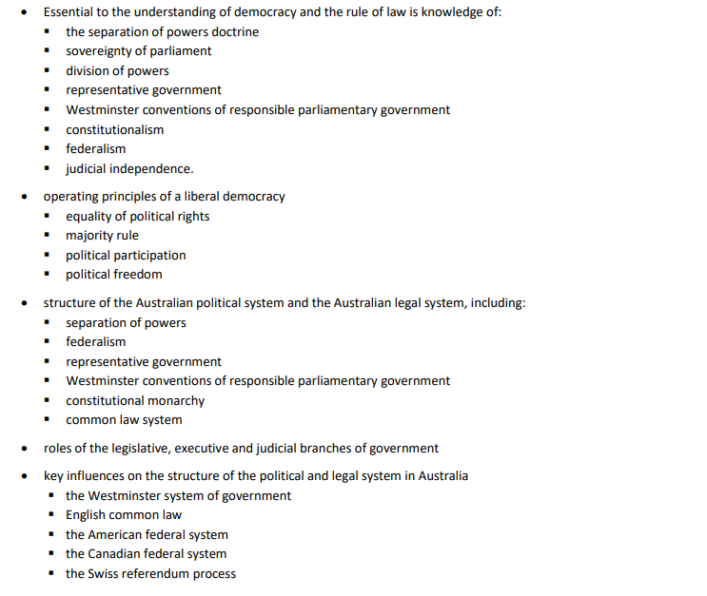
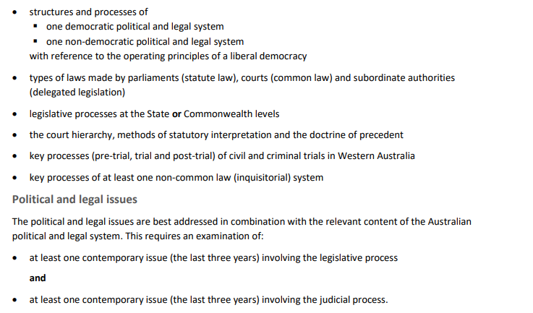
UNIT 1 SYLLABUS

Slide 4
Liberal Democracy
  characterised by fair, free and competitive elections between multiple political parties
  a separation of powers into different branches of government
  the rule of law in everyday life as part of an open society and the equal protection of human rights, civil rights, civil liberties and political freedoms for all people.
  To define the system in practice, liberal democracies often draw upon a constitution

Slide 5

KEY DEMOCRATIC TERMS
The rule of law
The separation of powers doctrine
Sovereignty of parliament
Division of powers
Representative government
Responsible government
Constitutional Monarchy
Constitutionalism
Federalism and
Judicial independence.

Slide 6
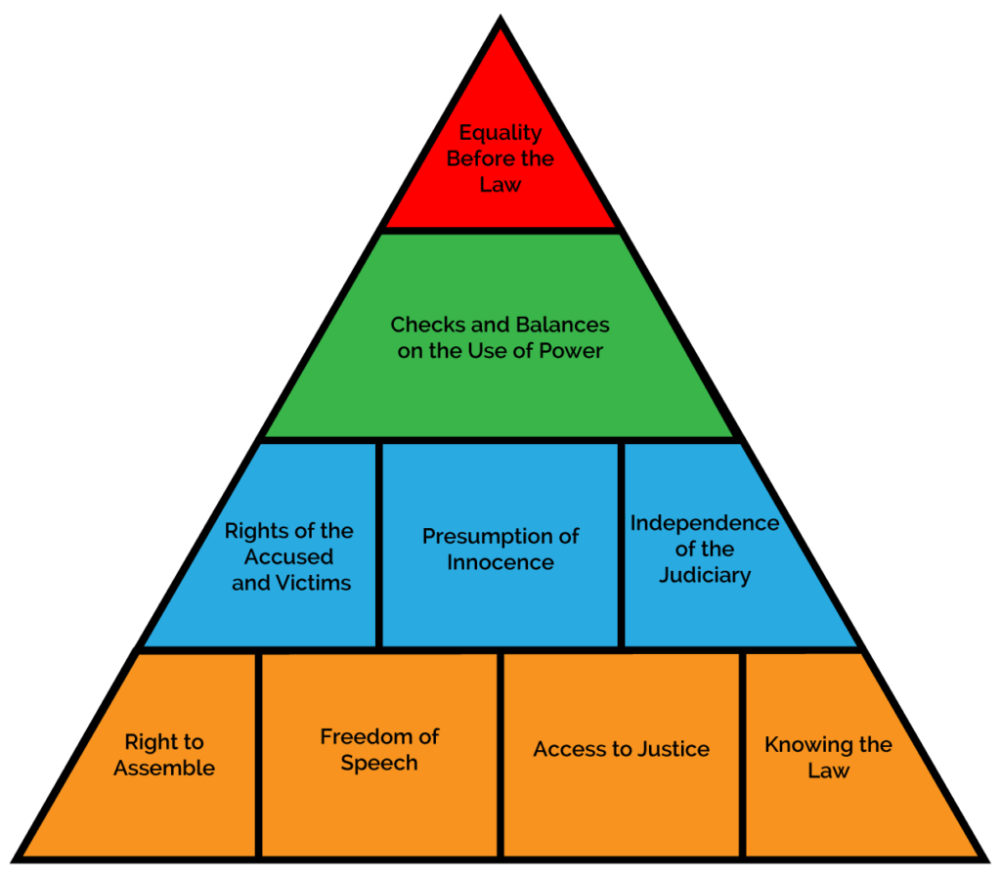
Rule of law

Slide 7

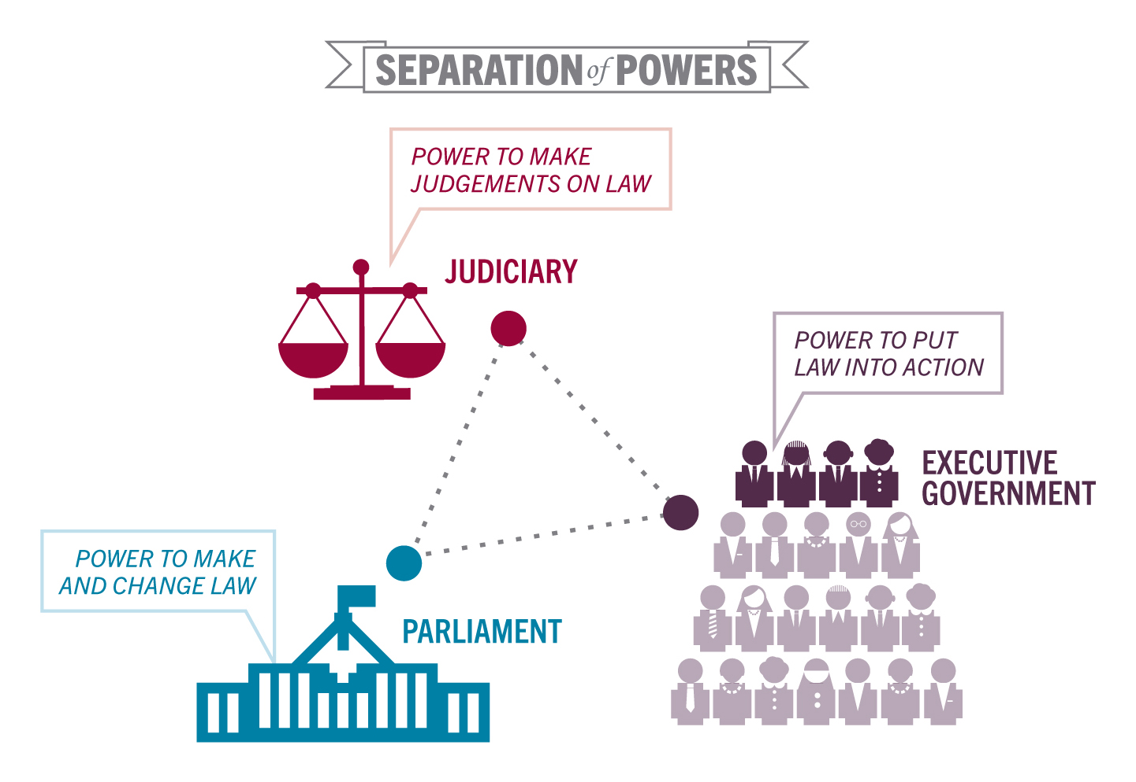
SEPERATION OF POWERS

Slide 8
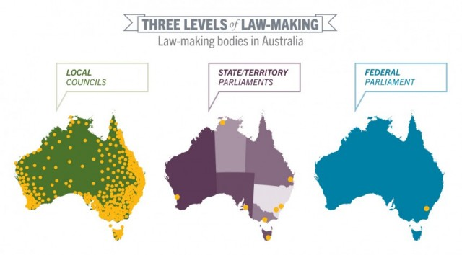
Division of powers

Slide 9
Representative Democracy
A form of Government in which people are sovereign/have a say, but are represented in government by elected members of a Parliament
Representatives in Australia are members of Parliament who represent the concerns and values of an electoral district (HoR), or of a state (Senate)
Regular elections maintain this
If a government does not reflect the views of the people they will most likely be voted out

Slide 10
RESPONSIBLE GOVERNMENT
Refers to the governments responsibility to the voters. A democratically elected government must be answerable and accountable to the people for its actions
Ministers are drawn from within the government (s. 64) and they must maintain the confidence of the government
Note: the Senate is able to scrutinize bills before they are passed and become law. This helps to ensure the government is being accountable to the people

Slide 11
RESPONSIBLE GOVERNMENT
The principles of a responsible government are:
  Ministers are responsible to parliament and therefore to the people – a minister can be called to explain in parliament his or her actions and those of the department and agencies under his or her control = ministerial accountability
  Members of parliament have the opportunity to question ministers about their activities and the activities of their department
  Minister must carry out their duties with integrity and propriety or resign
  There are opportunities for public scrutiny of the law-making process so the public can hold the government accountable or its actions; the government must respond to concerns/answer questions where appropriate
  If the government loses the support of the lower house it must resign

Slide 12
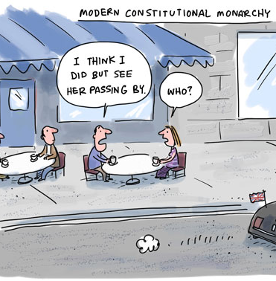
CONSTITUTIONAL MONARCHY
A form of government where the head of state is an inherited position but their powers are limited by a constitution
Australia’s Head of State = Queen and Governor-General

Slide 13
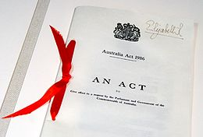
CONSTITUTIONALISM
The Constitution does the following:
  It outlines the functions and structure of Parliament
  It establishes the powers of Parliament
  It provides for the settling of disputes about the Constitution
  It outlines the procedures for changing the Constitution
The idea that government powers should be limited and not absolute – law limits power
Arose in the 18th century with discussion around colonial self-government
All democratic systems share the principles of constitutionalism

Slide 14
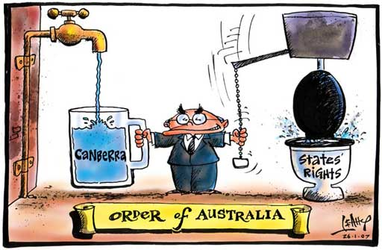
FEDERALISM
The main purpose of the Constitution was to create a federal compact = an agreed division of powers between the new Commonwealth Parliament and the State Parliaments

Slide 15
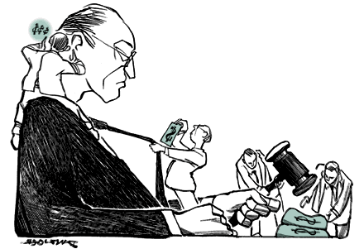
JUDICIAL INDEPENDENCE

Slide 16
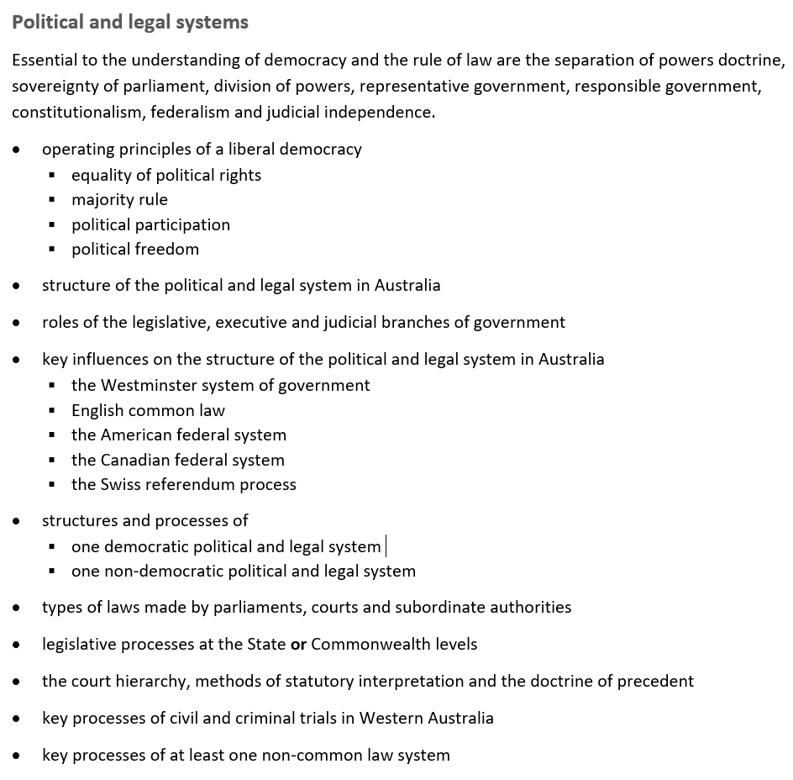

UNIT 1 SYLLABUS

Slide 17
DOT POINT 1: CHAPTER 1
Operating principles of a liberal democracy:
equality of political rights
majority rule/minority rights
political participation
political freedom
rule of law

Slide 18
A liberal democracy is the view that the ideal political system should combine majoritarian democracy (rule by the people) with the protection of the political, legal and social rights of individuals and minority groups.
Equality of political rights: All individuals should have equal access to Right to Vote; To Contest Elections; To Voice Political Opinions; Criticise Government Policies; Actively Participate in Governance, regardless of Gender, Ethnicity and Age e.t.c.
Majority Rule/Minority Rights: ‘supreme authority’ of voters to change the majority through elections. While it is clear that democracy must guarantee the expression of the popular will through majority rule, it is equally clear that it must guarantee that the majority will not abuse its power to violate the basic and inalienable rights of the minority. The minority, therefore, must have the right to seek to become the majority and possess all the rights necessary to compete fairly in elections. Majority rule is undermined in Australia through the 2 major party dominance.

Slide 19
Political Participation:
  The freedom to criticise and challenge the government and the right to organise politically, that is, to join political parties and pressure groups.
  Vote and remove unresponsive governments,
  making submissions to elected representatives;
  High Court cases such as the Roach Case.
  However, powerful interests dominate the political process and that groups more marginal to the system have difficulty in influencing decisions; not all citizens have the means to run for parliament; declining membership of political parties; declining registration of younger voters.
Political Freedom:
  Separation of Powers and constitutionalism which provides open and transparent government; Australia does not have an official Bill of Rights, however, some political rights are within our Constitution - right to a trial by jury (Section 80), implied freedom of political communication in Australia due to representative government.
  However, implied rights does not confer individual rights on individuals but rather prevents parliament from encroaching onto those areas (freedom from political interference); Some rights are protected through common law: the right of access to the courts and privilege against self-incrimination
  Note: some of these common-law rights such as privilege against self-incrimination have been abandoned due to terrorism

Slide 20
Rule of Law:
  The separation of powers between the legislature, the executive and the judiciary.
  The law is made by representatives of the people in an open and transparent way.
  The law and its administration is subject to open and free criticism by the people, who may assemble without fear.
  The law is applied equally and fairly, so that no one is above the law.
  The law is capable of being known to everyone, so that everyone can comply.
  No one is subject to any action by any government agency other than in accordance with the law and the model litigant rules, no one is subject to any torture.
  The judicial system is independent, impartial, open and transparent and provides a fair and prompt trial.
  All people are presumed to be innocent until proven otherwise and are entitled to remain silent and are not required to incriminate themselves.
  No one can be prosecuted, civilly or criminally, for any offence not known to the law when committed.
  No one is subject adversely to a retrospective change of the law

Slide 21

UNIT 1 SYLLABUS

Slide 22
DOT POINT 2 : CHAPTER 2
Structure of the political and legal system in Australia (division of powers)
The Constitution sets out clearly the division of powers between the State and Federal Governments. It does this by stating the powers given to the Federal Government and then providing that the powers not mentioned remain with the states = residual powers
The Constitution allows the states to make laws in areas over which the Commonwealth has power (provided that the state laws do not conflict with those of the Commonwealth). This occurs where the states and the Commonwealth have concurrent powers – that is, a shared power to legislate. E.g. Taxation
Note: If there is a conflict of interest between the states and the Federal Government, or if there is an inconsistency in these laws, the federal laws prevail over state law (s. 109)

Slide 23
DIVISION OF POWERS
The Constitution outlines specific powers given to the Commonwealth by the states.
Specific powers:
  Exclusive: powers that can only be exercised by the Federal Parliament
  Concurrent: powers that can be exercised by both the states and the Commonwealth
Residual powers
  Before Federation, each colony had its own set of powers. At Federation some of those powers were handed over to the Commonwealth (s. 51). The remaining powers stayed with the states (s. 108); they are called the residual powers and only the states can makes laws based on these powers

Slide 24
Specific Powers
Note: S. 51 lists 40 areas over which the federal Parliament has legislative power. Most specific powers are contained in this section (39 paragraphs)
Exclusive:
  S. 90: the power to impose customs and excise duties
  S. 114: prohibits the states from raising naval or military forces
  S. 115: prohibits the states from minting their own coins
Concurrent:
  S. 51
    Trade and commerce with other countries
    Taxation
    Postal, telegraphic and similar services
    Marriage
    divorce

Slide 25
Residual Powers
Examples of residual powers can be found in the areas of:
  Law and order (police; prisons)
  Commerce and industry
  Education
  Housing
  Transport
  Development (roads; railways; utilities – electricity; water supply)
  Public health (hospitals; ambulance services) and social welfare issues

Slide 26
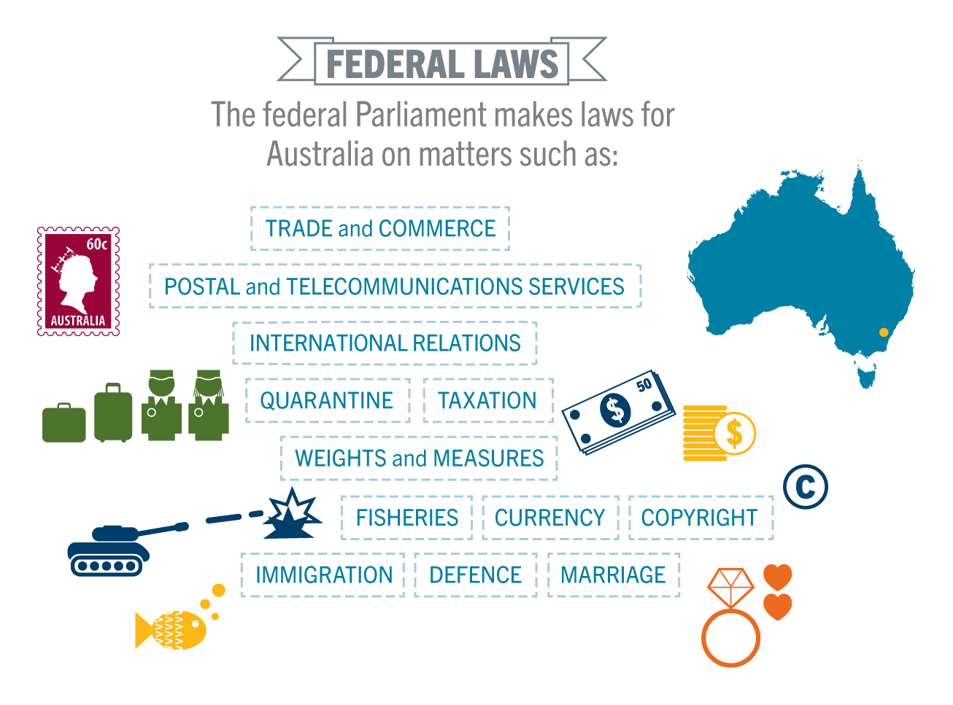

Slide 27
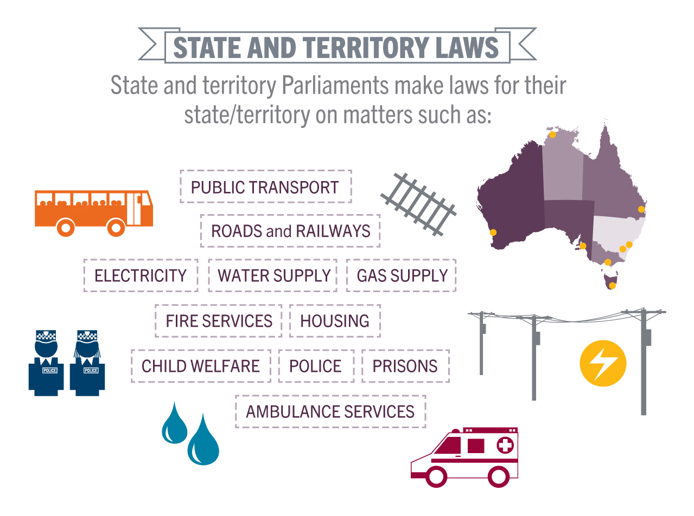

Slide 28


Slide 29

UNIT 1 SYLLABUS

Slide 30
DOT POINT 3 : CHAPTER 2
Roles of the legislative, executive and judicial branches of government (separation of powers)
“ The division of government executive, legislative and judicial powers into separate arms or institutions that act separately and are independent of each other. The separation of powers was advocated by the French political thinker, Baron d’Montesquieu, as way of ensuring that governments could not wield excessive power. The separate arms of government provide a system of checks and balances on each other. The most important feature of the separation of powers is the independence of the judiciary”.

Slide 31
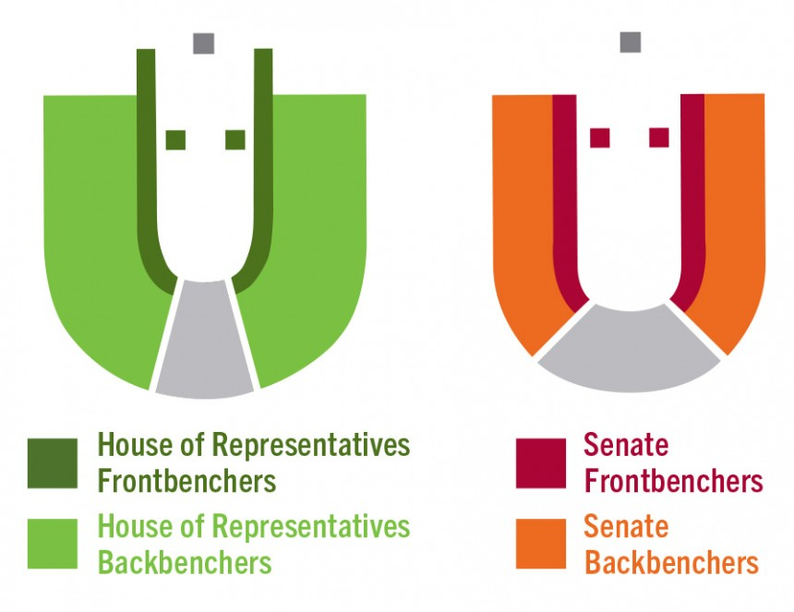
LEGISLATIVE BRANCH
Chapter 1
Who is in the Legislative?
How is Chapter 1 divided?
What does section 53 state?
What does section 7 and 24 state?

Slide 32
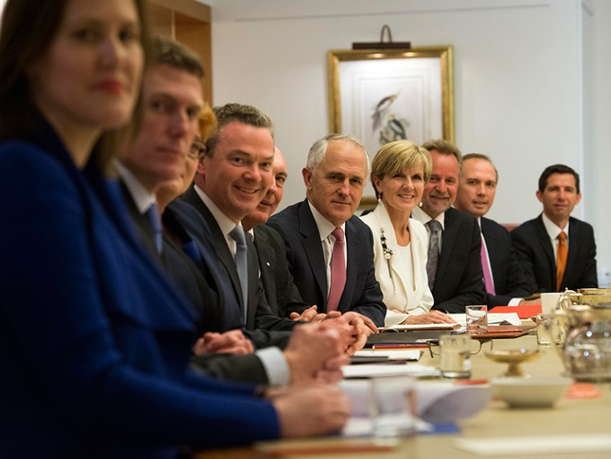
Composition
Executive government consists of:
  Governor-General as Head of State (formal executive)
  The Prime Minister (Head of Government) and Ministers (political executives)
  Also includes public service and other agencies who deal with day-to-day implementation of laws (administrative executive)
Each minister is an elected member of parliament as well as being responsible for the management of their department.
Appointment
The Prime Minister is the leader of the party or coalition (partnership of parties) who forms the government, and has been chosen as leader by a vote of the parliamentary members of this party.
The Prime Minister normally selects ministers who are then commissioned by the Governor-General.
EXECUTIVE BRANCH Chapter 2

Slide 33
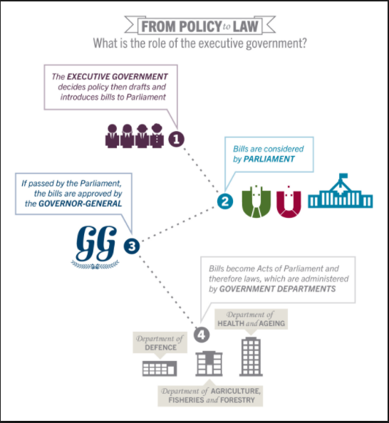
Responsibility
The executive is responsible to the Parliament and each minister must answer to the Parliament for the operation of their department and the laws they introduce and administer.
The executive can be scrutinized in both the House of Representatives and Senate particularly in Question Time.
They have the power to carry out/execute laws….how?
By developing policies and implementing statues

Slide 34
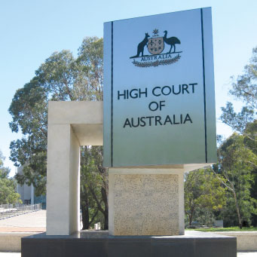
The Judiciary makes judgements/interpretations about the law, they adjudicate and make legally binding decisions (court decisions are law)
The Judiciary is made up of the High Court and other federal courts - The High Court is established by the Constitution. Other federal courts are created by legislation of the Parliament.
One of the major functions of the High Court is to interpret the Constitution. The High Court may rule a law to be unconstitutional—that is, beyond the power of the Parliament to make—and therefore of no effect (checks and balances)
Judges are appointed by the Governor-General acting on the advice of the Prime Minister and Cabinet
JUDICIARY Chapter 3

Slide 35












UNIT 1 SYLLABUS

Slide 36
DOT POINT 4 : CHAPTER 3
Key influences on the structure of the political and legal system in Australia:
the Westminster system of government
English common law
the American federal system
the Canadian federal system
the Swiss referendum process

Slide 37

Westminster system of government
Obviously any formal political activity of the new national government would follow the British model of responsible parliamentary government. However, these are mostly left to constitutional conventions rather than being specified in the Constitution itself.
The Westminster influence:
Responsible government (Ministers are collectively and individually responsible to the parliament; The PM and Ministry must have majority support in the lower house)
Fusion of the Separation of Powers (section 64) - The Prime Minister is a member of the lower house, and Ministers must be members of parliament; Ministers are collectively and individually responsible to the parliament
Unwritten and written constitution
Constitutional conventions
Bicameralism
English common law
Head of State = British monarch and Head of Government = PM (The GG acts on the advice of the PM
An independent judiciary

Slide 38

AMERICAN FEDERALISM
Federalism (Sovereignty is shared and powers divided between two levels of government, the C'th and the States)
Division of Powers between central and State governments (s.51,52, 107-108)
The Senate (State’s house)
The Judicial branch (The High Court / Supreme Court)
Written Constitution to outline powers of Parliament (The founding fathers borrowed extensively from the US Constitution - The Constitution envisaged the two levels of government operating independently of one another
Double Majority Referendum process in that a majority of voters in a majority of States which approve.

Slide 39

CANADIAN SYSTEM
Section 51 = Section 91
Responsible government
The concept of ‘Washminster’ – combination of USA federalism and UK Westminster system

Slide 40

SWISS REFERENDUM
Referendum – Neither the states nor the broader community have any role in initiating referendum proposals
The process is complex to change Constitution
It encourages public discussion and delay change until it is desirable, irresistible and inevitable

Slide 41

UNIT 1 SYLLABUS

Slide 42
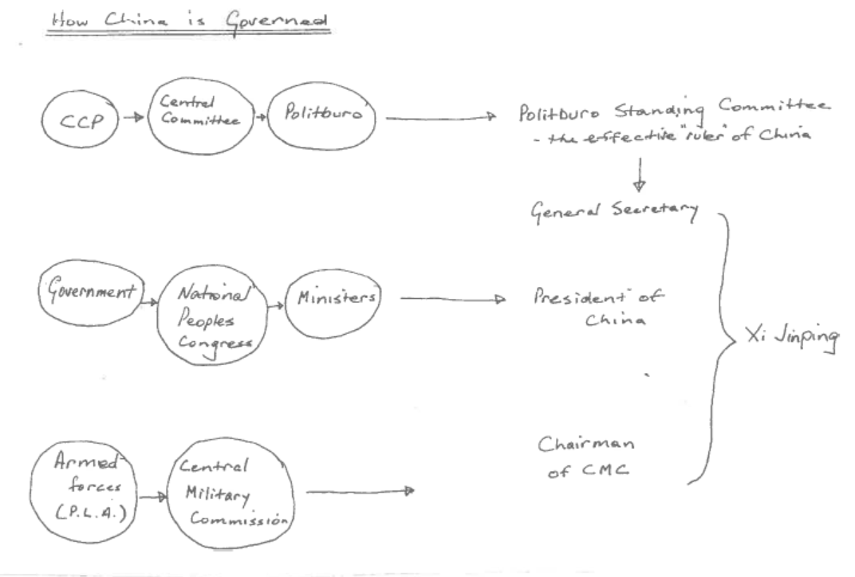
DOT POINT 5: CHAPTER 4
Structures and processes of
one non-democratic political and legal system (China)

Slide 43
1. THE PARTY (CCP)
Under the Constitution, the CCP is the leading political party
The CCP controls citizens at all levels
Parliament is a unilateral legislature (only law-making body)
Theoretically this power lies with the National People’s Congress (NPC) however…
CCP is the real instrument of power
CCP meets every 5 years, the CCP Constitution is different to the State Constitution

Slide 44

How to join CCP
Must be over the age of 18
Committed to party policy and programs
In 2011, 21.6 million applied and less than 15% accepted
Less than 25% are women
Members are organised into branches, which exist in all institutions and organisations (even private businesses)

Slide 45
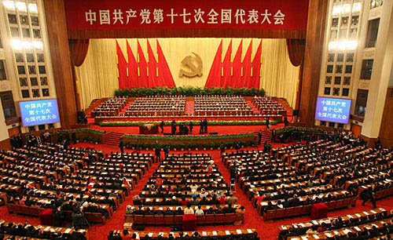
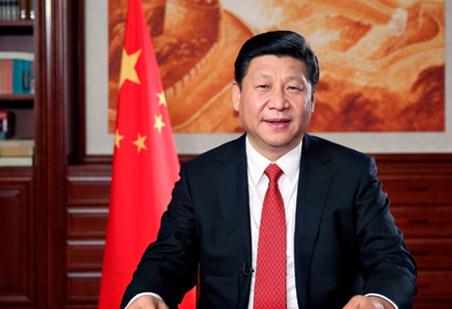
NPC (National Party Congress)
Every 5 years there is an election of a new committee.
Politburo Standing Committee selected (7 members)
Politburo are selected (25 members)
The Party Secretariat is also selected (day to day running of things)
The General Secretary is also chosen, who is the leader of the CCP (therefore leader of China – Xi Jinping)

Slide 46
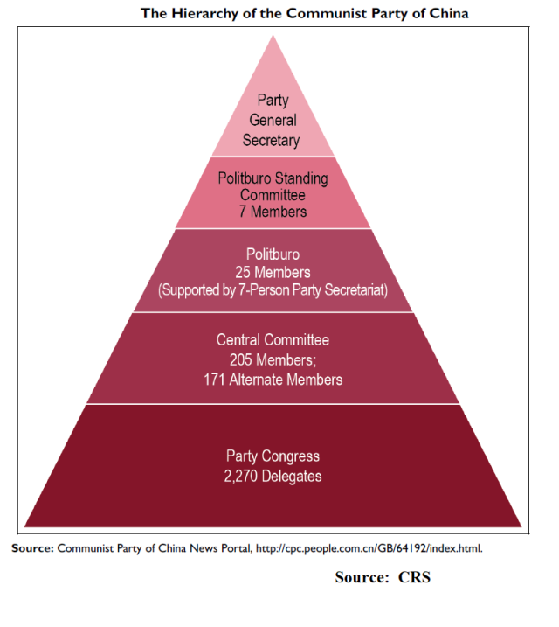
Structure of communist party
Politburo Standing Committee:
- Most senior body
- Spread ideology and propaganda
- Deals with corruption
- Oversees foreign policy
Poltiburo:
Represent party interests
Recruits/trains new party members
Controls all media, sets official message of Party
Deals with Supreme Court, justice and state security

Slide 47





DOT POINT 5 CHAPTER 4
Structures and processes of
one non-democratic political and legal system (China)

Slide 48

2. THE STATE
The State is not as powerful as the Party
Party members fill many of the committees and the roles within the State
Why?
So they can control all areas of public life

Slide 49
The State President (Govt)
This is China’s head of state
Who is also?
The General Secretary of the CCP
The party nominates the candidates for President and Vice-President, they are then elected by the NPC
However…the General Secretary outranks the NPC…so what does that mean?
The President: announces laws, appoints/dismisses government positions, receives foreign diplomats, signs treaties, announces emergency or declaration of war

Slide 50
The State Council (Govt)
Also known as Central People’s Government (CPG)
State Constitution – it is the highest organ of state administration
It officially implements CCP policies and enacts law passed by NCP
It also manages day-to-day admin of the economy
Similar to Cabinet is the sense that it has a vast array of organisations under its supervision
The Premier leads the State Council and is appointed by…
The President, who is?
The General Secretary of the CCP

Slide 51
National People’s Congress (Govt)
‘Highest organ of State Power’
Enacts/revises laws
Proposes amendments to the Constitution
Ratify/annul treaties
Approve State Budget
Elect and dismiss top officials of state and judiciary
The CCP is the one in reality who fulfils these roles, the NPC is the body who approves Party decisions

Slide 52
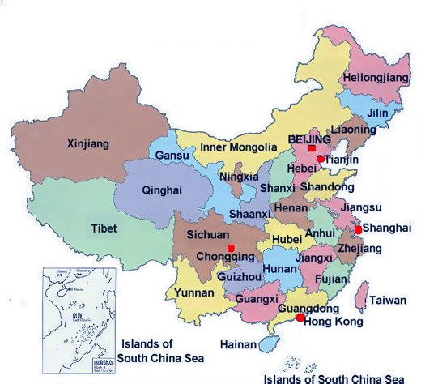
National People’s Congress (Govt)
The NPC meet for 10 days every year
They serve 5 year terms
Congress members are nominated by CCP and elected by electoral units (these represent provinces and regions throughout China)
Because the NPC don’t sit for long, the Standing Committee do most of the work, they meet every 2 months and has 161 members

Slide 53

DOT POINT 5 CHAPTER 4
Structures and processes of
one non-democratic political and legal system (China)

Slide 54
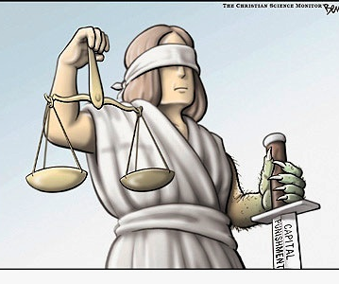
The Judiciary
Is the judicial system independent of the government?
Do fish like water?
The Supreme People’s Court is the highest court
Reports work to NPC.
The SPC functions:
  Hears appeals
  Approves death sentence
  Discovers mistakes in other courts

Slide 55

Principals of Supreme Court?
Equality
Open trials
Defence
Panels
System of challenge
However, the Party supports rule by law not rule of law – so Party is not subject to confines of the law
The Party commissions oversee polices, prosecutors and the courts
They can intervene in matters to ensure the CCP’s interests are met
Who appoints judges? …. NPC

Slide 57

EVALUATION OF NON-DEMOCRATIC SYSTEM
Elections are not free or fair
Strong censorship
Abuse of civil liberties
Repression of criticism of government; human rights abuses; political prisoners
One party rule
Lack of judicial independence
Rulers and the government not held accountable for their actions
Political parties forbidden
Freedom of movement limited
Constitutionalism limited

Slide 58

UNIT 1 SYLLABUS

Slide 59
DOT POINT 6: CHAPTER 5
Types of laws made by parliaments, courts and subordinate authorities (delegated legislation)
Laws made by parliament are known as statute laws
Laws made by parliament override a law made by the courts (parliamentary sovereignty)
A statute law is binding on the whole community
‘In futuro’ by predicting future causes of conflict and setting up ways of dealing with them; they apply to future situations and not retrospectively
Delegated Legislation:
Parliament can pass delegated legislation
This gives authority or government departments and subordinate authorities to create legally binding regulations
The act that allows this is called an enabling act
An enabling act sets out the general principles of the law
However, it allows for the creation of an extensive body of specific regulations or bylaws
Example: the Local Government Act provides delegated authority for a huge range of local regulations and bylaws

Slide 60

UNIT 1 SYLLABUS

Slide 61
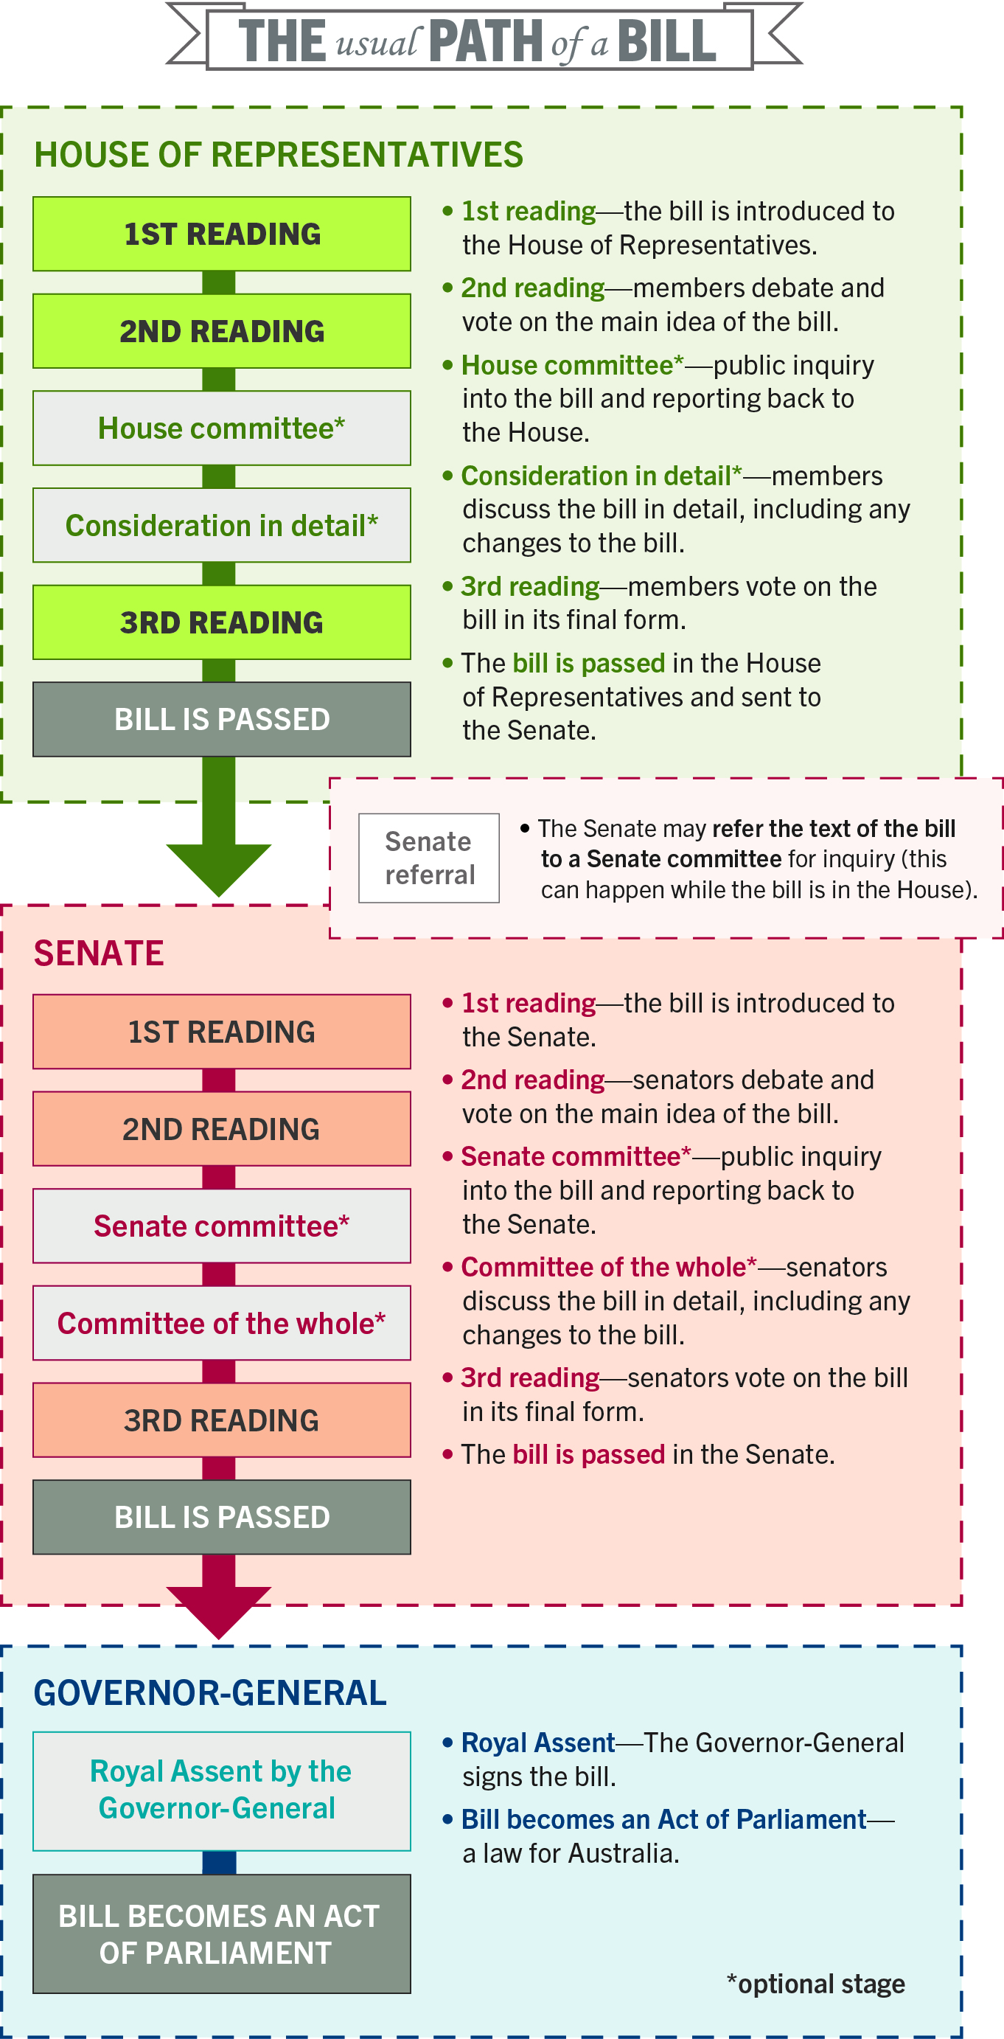
DOT POINT 7: CHAPTER 5
Legislative processes at the State or Commonwealth levels (legislative process)
Stages of the law making process- First Reading; Second Reading; Consideration in Detail Stage; Third Reading; Passage to the Senate; Royal Assent and Proclamation.
Key terms: Legislation; Statute; Bill; House of Representatives and Senate; Parliament; Government; Executive dominance (gags, guillotines, flood-gating) and partisan discipline; Hostile Senate.

Slide 62

UNIT 1 SYLLABUS

Slide 63
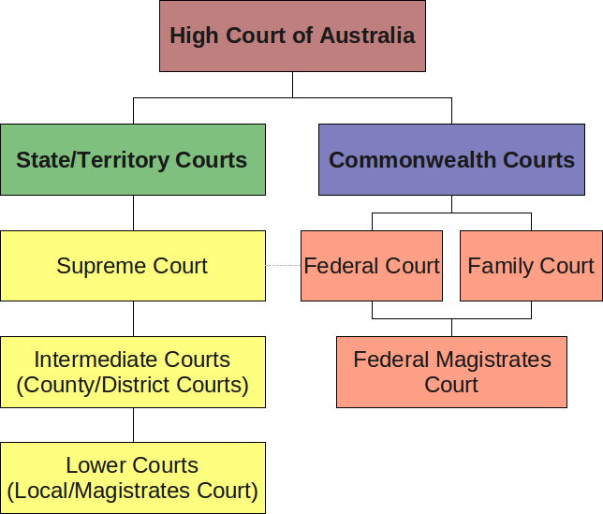
DOT POINT 8:
CHAPTER 6
The court hierarchy, methods of statutory interpretation and the doctrine of precedent
(handout to give)
1. Court Hierarchy

Slide 64
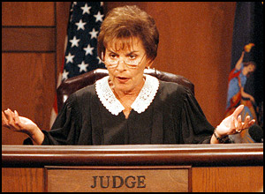
DOT POINT 8: CHAPTER 6
2. Statutory Interpretation:
What is this?
Why is it necessary?
Are judges limited in their ability to interpret statute?
Types:
Literal Rule
Golden Rule
Mischief Rule
Purpose Approach

Slide 65
DOT POINT 8: CHAPTER 6
3. Precedent:
Precedents are exclusively set by higher courts
All lower courts are bound by the decisions of higher courts in the same hierarchy
Decisions by courts at the same level are not binding
Decisions of courts provide the legal principles upon which precedents are created.
Binding v Persuasive precedent
Case Example: Donoghue v Stevenson, Mabo
Key terms: Stare decisis, Ratio Decidendi, Obiter Dictum

Slide 66
Stare decisis
'stand by what has been decided and do not unsettle the established'.
Under common law the judgements of courts are based on precedents set by previous judges faced with similar circumstances.
This is the principle of stare decisis
This supports the idea of fairness and provides certainty in the law.
Parties to a dispute argue their case in court by citing earlier cases and the key reasons for judges decisions – ratio decidendi

Slide 67
Ratio decidendi
‘The reason for deciding’
In a judgment the judge is likely to give a summary of the facts of the case, review the arguments put to him by the advocates in the case, and then explain the principles of law he is using to come to the decision.
These principles are the important part of the judgment and are known as the ratio decidendi.

Slide 68
Obiter dicta
‘Other things said’
Judges in future cases do not have to follow this.
Sometimes a judge will speculate on what his decision would have been if the facts of the case had been different.
This hypothetical situation is part of the obiter dicta and the legal reasoning put forward may be considered in future cases, although, as with all obiter statements, it is not binding precedent.

Slide 69
SUMMARY OF KEY TERMS
Stare decisis = the Law expounded in one case should be followed in later, similar cases
Obiter Dictum = persuasive, not binding….but should not be ignored
Obiter dictum (‘saying by the way’) statements are made in a judgment but do not constitute part of the ratio decendi, therefore they are not part of any precedent
can provide important information and guidance for future judges
Ratio Decidendi = legally binding principle;
The key reasons or core principle underlying a court judgement in common law
The ratio decidendi of a higher court forms the precedent that is binding on the decisions of a lower court

Slide 70
Judges in the superior court may take four different actions in changing the existing decision:
Reversing the decision
  If the higher court finds the law has been misapplied it will reverse the judgement and substitute a correct ratio decidendi for the ratio decidendi used by the lower court
  Occurs on the same case
Overruling
  A superior court may reconsider a case where the legal principle used was created in a previous judgement of a lower court
  It may not find that precedent convincing and as a result substitute its own ratio decidendi
  Occurs when 2 separate cases
Disapproving
  This occurs when a judge disagrees with previous judgement and puts in his statement, the court decides not to follow a previous decision set by a court at the same level.
  The High Court sometimes takes this action and creates ‘new law’
Distinguishing
  If a court decided that the case before it is substantially different from any previous case, its decision will be different or distinguished from existing precedents

Slide 71
UNIT 1 SYLLABUS

Slide 72
DOT POINT 9: CHAPTER 7
Key processes of civil and criminal trials in Western Australia

Slide 73
CIVIL TRIAL PROCEDURE
(PRE, TRIAL, POST)
PRE-TRIAL
Aim?
Pleadings (writ, notice of appearance, statement of claim, statement of defence)
Discovery (interrogatories, discovery of documents, medical reports)
Directions Hearing
Mediation (ADR)
TRIAL
Aim?
Indictment read
Plea
Prosecution: Opening Statements, Examination in Chief, Cross-Exam, Re-Exam
Followed by defence
Closing address
Judge clarify points of law
Jury retire
POST-TRIAL
Aim?
Remedies:
  Damages (compensatory, punitive, nominal, contemptuous)
  Injunctions
  Specific Performance
  Restitution
  Recession
Appeal

Slide 74
CRIMINAL TRIAL PROCEDURE
(PRE, TRIAL, POST)
PRE-TRIAL
Aim/Purpose?
Summary/Indictable
Reporting, Investigation. Arrest
Summary: no warrant, Magistrates, criminal summons served on accused
Indictable: warrant, Magistrates, plea, committal sentence (guilty) committal mention (not guilty), bail/remand
Directions Hearing, Status Conference
TRIAL
Aim?
Summary – Magistrates, no jury
Indictment read
Plea
Prosecution: Opening Statements, Examination in Chief, Cross-Exam, Re-Exam (rules of evidence)
Followed by defence
Closing address
Judge clarify points of law
Jury retire
POST-TRIAL
Aim:
  Retribution
  Deterrence
  Rehabilitation
  Protection
  Restorative Justice
Sanctions:
  Custodial (suspended)
  Community work
  Fines, Bond
  Home Detention
  Note: mitigating and agg.
Appeal

Slide 75


UNIT 1 SYLLABUS

Slide 76
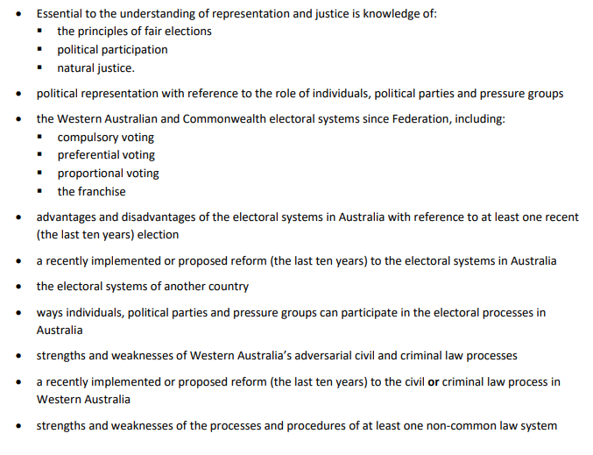
UNIT 2 SYLLABUS

Slide 77
Natural Justice
Definition
  A principle of justice incorporating the rule against bias and the right to a fair hearing. Fair processes for determining the truth in a dispute, also known as ‘due process’. Courts and tribunals have a duty to act fairly.
Key elements:
Impartiality or a rule against bias
  Nemo iudex in causa sua means ‘no one is to be a judge in their own cause’.
The right to a fair hearing
  Audi alteram partem means ‘to hear both sides’
Basing decisions on evidence
Having open and transparent processes (open courts)

Slide 78
Adversarial vs. Inquisitorial
An inquisitorial system is a legal system where the court or a part of the court is actively involved in investigating the facts of the case, as opposed to an adversarial system where the role of the court is primarily that of an impartial referee between the prosecution and the defense.
Inquisitorial: actively investigates facts of case
Adversarial: impartial referee
The adversary system and the inquisitorial system are two extremes on a continuum of trial procedure. While the Australian legal system adopts a predominately adversarial approach, there are also some elements of inquisitorial procedures in our legal system
  E.g.: coronial inquests; Family Court (child-related); ADR; tribunals
Major points of comparison:
  Role of the decision-maker
  Party control
  Objective – get at truth or win the case
  Rules of evidence and procedure

Slide 79
Adversarial Court Process
Definition:
  The adversarial system is a legal system used in the common law countries where two advocates represent their parties’ positions before an impartial person or group of people, usually a judge or jury, who attempt to determine the truth of the case.
Major Features:
  Role of the parties
  Role of the judge
  Burden of proof and standard of proof
  Need for rules of evidence and procedure
  Need for legal representation
Note Resources:
  Adversarial vs. Inquisitorial PP
  Civil vs. Criminal Trial Procedure PP

Slide 80
Adversarial Court Process
Strengths:
  Parties are able to fight their own battle
  Each party can choose their legal representative to present their case in the best light
  The party bringing the case has to prove the facts to the standard of proof required
  The judge is impartial, makes sure the parties are treated fairly, and is independent of the State and the parties
  Rules of evidence and procedure make the process fair
  Oral evidence helps to reveal if a witness is sincere
  Cross-examination helps to bring out the truth

Slide 81
Adversarial Court Process
Weaknesses
  Party control potentially leading to animosity between the parties, high costs of legal representation, delays which cause hardship
  Is more concerned with winning than getting at the truth
  The judge cannot help the parties to get the right result
  Relies on both sides being equally represented
  Oral evidence may not be ideal because witnesses could be intimidated, witnesses can only respond to questions, expert evidence could be too heavily relied upon
  Not all evidence may be brought out
  The truth may not be reached

Slide 82
Inquisitorial Court Process
Definition:
  An inquisitorial system is a legal system where the court or a part of the court is actively involved in investigating the facts of the case
Major features:
  Role of the judge
  Role of legal representatives and parties
  Trial evidence and procedure
  Burden of proof and standard of proof

Slide 83
Inquisitorial Court Process
Strengths
  The decision-maker takes a more active role
  Witnesses are mostly called by the decision-maker
  There is less reliance on legal representation
  The decision-maker controls the production of evidence
  The cost of an inquisitorial system of trial is mainly borne by the State
  The use of mainly written statement reduces the cost
  Separation of roles of judge, investigator (police) and lawyers could lead to a fairer outcome

Slide 84
Inquisitorial Court Process
Weaknesses
  The judge is less impartial than in the adversary system
  Greater reliance on written evidence
  Parties not able to call their own expert witnesses
  The parties may feel at the mercy of the investigating judge
  Judge is aware of character reports and past record
  Too much power in the hands of one individual (the judge)

Slide 85
Indonesian System of Trial
Major features:
Civil Law system
Inquisitorial system of trial
  Judge conducts an enquiry into the truth of what occurred, that is, the facts behind the legal issues in dispute
  Judges control the proceedings and may directly question witnesses
  Less emphasis on the rules of evidence as judges tend to allow most material in and then decide on its merits at a later point
  Police conduct initial investigation then hand a brief to the prosecution
No doctrine of precedent = not bound by decisions of courts at the same level or higher
The layout of an Indonesian court reflects the inquisitorial nature of Civil Law proceedings
  Judges face the witness
  Lawyers are placed off to the sides, reflecting their relatively reduced significance in proceedings

Slide 86
ADR
ADR = Alternative Dispute Resolution
  A way of resolving disputes between two or more parties
  Third party acts as mediator and assists the parties to negotiate a settlement
  An alternative to the court process AND less costly
  Mediation is the most widely used form of ADR
  Other forms of ADR: conciliation and arbitration
Mediation
  intervention in a dispute in order to resolve it
  Neutral third party assists disputing parties in resolving conflict through the use of specialized communication and negotiation techniques
  All participants in mediation are encouraged to actively participate in the process
  Mediation is “party-centered” process in that it is focused primarily upon the needs, rights and interests of the parties

Slide 87
TOPICS
Australia’s Political Landscape
  Colonial – Federation
  Influences
  Constitution
  Liberal Democracy
Democratic vs. Non-democratic Systems
  China
Legislative Process
Statutory Interpretation
Doctrine of Precedent
Adversarial vs. Inquisitorial Systems
  Indonesia
  ADR
  Civil Trial Procedure
  Criminal Trial Procedure

Slide 88
Terminology & Abbreviations
[Requirement: explanation & example]
Absolute Monarchy
Accountability
Acquittal
Act of Parliament
Admissible evidence
Adversarial system
ADR
Appeal
Aristocracy
Autocracy
Backbencher
Balance of power
Balance of probabilities
Beyond reasonable doubt
Bicameral Parliament
Bill
Binding precedent
Burden or onus of proof
Cabinet
Case law
Check and balances
Children’s court
Citizenship
Civil dispute
Civil law
Committal Mention
Committee
Committee of the Whole
Consideration in detail stage
Common law
Concurrent power
Constitution
Constitutionalism
Constitutional Monarchy
Contract law
Conciliation and mediation
Conventions
Criminal law/dispute
Criminal sanctions
Crossbench
Damages
Defendant
Delegated legislation
Democracy
Dictatorship
Direct democracy
Disapproving
Discovery of documents
Distinguishing
District Court WA
Division of Power
Doctrine of Precedent
Double dissolution
Double majority
Dual Federalism
Due Process
Duty of care
Ejusdem generis
Evidence
Examination of witnesses
Executive dominance
Exclusive powers
Executive
Ex post facto
Family Court
Federal Court
Federalism
Federation
Flood-gating
Franchise
Front bench
Further and better particulars
Gags
Golden rule
Good Government
Governor
Governor General
Guillotine
Habeas Corpus
Hansard
Head of State
Hearsay evidence
High Court of Australia
House of Representatives
Inadmissible evidence
Indictable offence
Injunction
Inquisitorial system
Interrogatories
Judiciary
Jury
Legislation
Legislative Assembly
Legislative Council
Legislature
Liberal Democracy
Liberalism
Literal rule
Magistrates Court
Mens Rea
Mischief rule
Monarchy
Obiter dictum
Oligarchy
Overruling
Parliamentary Privilege
Persuasive precedent
Plaintiff
Pleadings
Preferential Voting
Presumption of innocence
Private Member’s Bill
Proportional representation
Ratio decidendi
Referendum
Remand
Remedies
Representative democracy
Responsible Government
Restitution
Reversing
Royal Assent
Rule of Law
Rules of Evidence
Secret ballot
Senate
Separation of Powers
Simple offence
Sovereignty
Specific performance
Standard of proof
Standing committees
Standing Orders
Stare decisis
Statute
Statutory interpretation
Subpoena
Suffrage
Supreme Court of WA
Terra nullius
Tort
Trial
Unicameral Parliament
Warrant
Washminster Hybrid
Westminster conventions
Writ

Slide 89
Constitutional Sections
Specified Constitutional rights
  41
  51(xxxi)
  80
  92
  116
  117
Division of Powers
  Exclusive
    51(by nature); 52; 90; 115
  Exclusive/Concurrent
    51; 92
  Residual
    106; 107; 108
Legislative/
  1
  2
  7
  24
  44
  51
  52
  53
  58
Executive
  61
  64
Judiciary
  71
  80
  109
Constitutional change
  128

Slide 90


